Slide 1
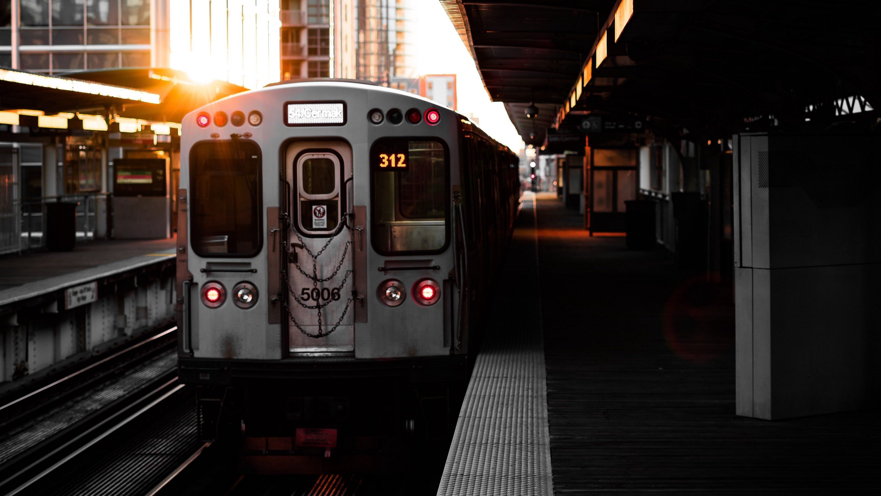

Metro Railway Reservation Management

Slide 2

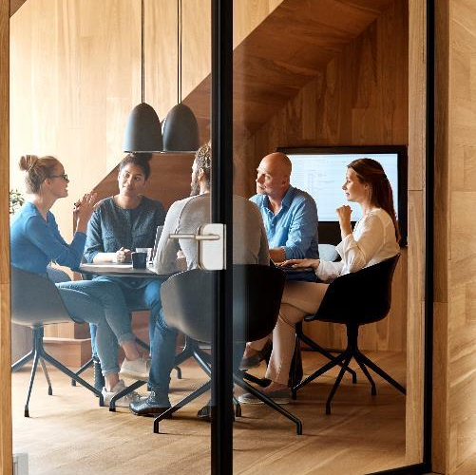

Team members:
A.Venkata Dinesh Reddy
(RA1911028010098)
CH.Vamshi Krishna (RA1911028010099)
Kannanoor Spurgeon (RA1911028010109)

Slide 3
INTRODUCTION
Booking tickets in online makes an easy way to overcome the needs of the problems facing by the people such as standing in the queue and missing the trains. This system is a web based application which provides information regarding reservation booking.
Users can recharge their railway wallet online and can buy the metro tickets in the form of QR-code
The information about a particular user is stored in cloud database for continuous and easy availability reached.
For security reasons the information about every user is stored in cloud which is to be accessed for each ticket booking for validation purpose.
During signup, the user has to enter his details like Aadhaar number, username, mobile number etc which will be stored in the firebase.

Slide 4
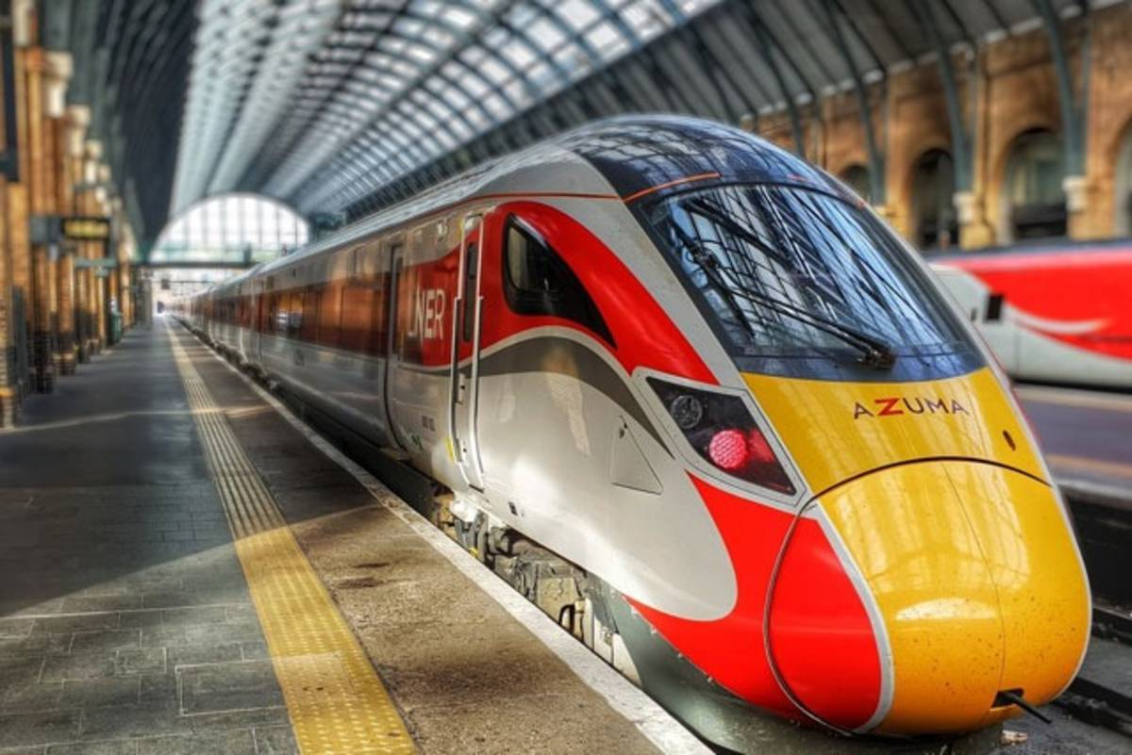
IMPLEMENTATION:-
For booking the metro ticket the user has to register by entering his details like Name, mobile number etc. After registering the user can login, if he enters invalid password /username then he will not be able to book his ticket, but if it is valid, then he can book his ticket. The ticket is generated in the form of QR-Code and ticket checker scans the ticket by QR-Code Reader to validate the ticket.

Slide 5
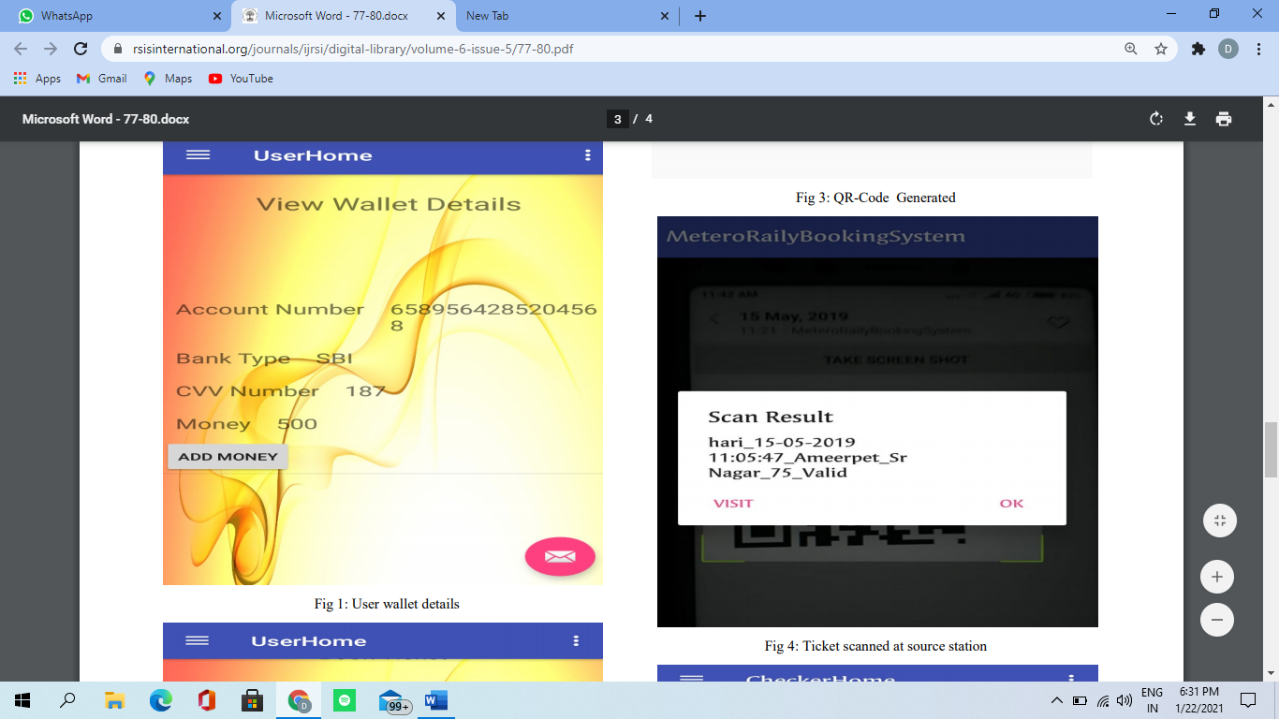
STEP-1
Personal Information Gathering: The work here starts with installing our application. It gathers the basic information about the user like Aadhaar number, Name, mobile number, etc. and these details are stored in the firebase. When the user wants to buy the ticket just he need to enter his username and password which is sent to firebase for security purpose.
Filling user Details

Slide 6
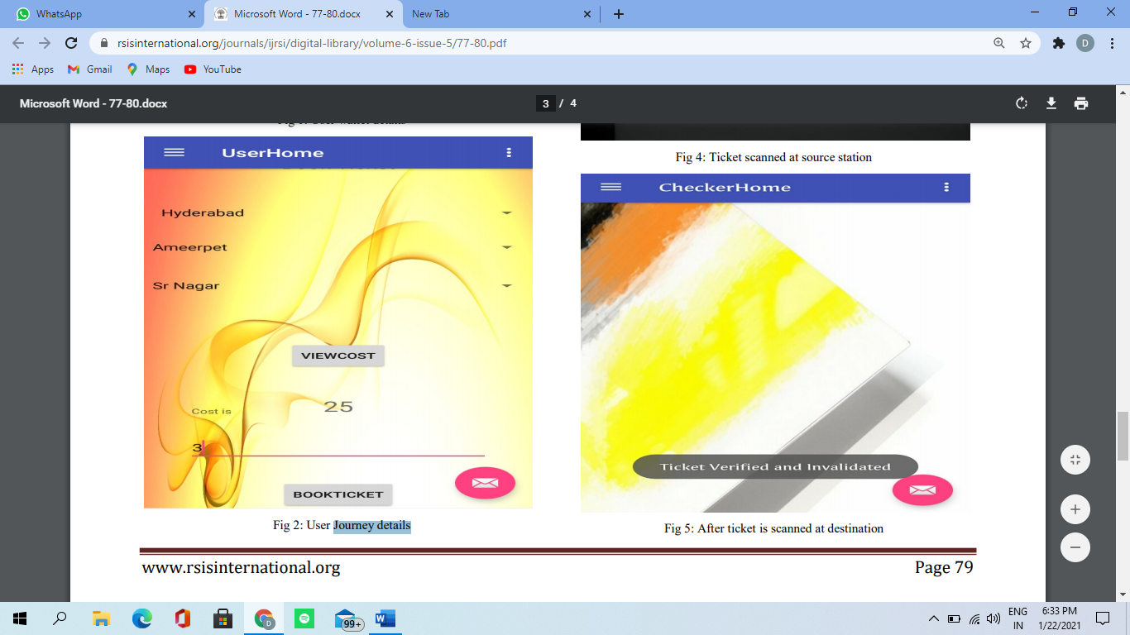
STEP-2
Ticket Buying: Once the user has successfully login, then he can book the ticket by selecting the source station, destination station and number of tickets required. The cost of booked tickets will be displayed below when user click on submit button the amount will be deducted from user railway wallet and ticket will be generated.
Booking Ticket

Slide 7
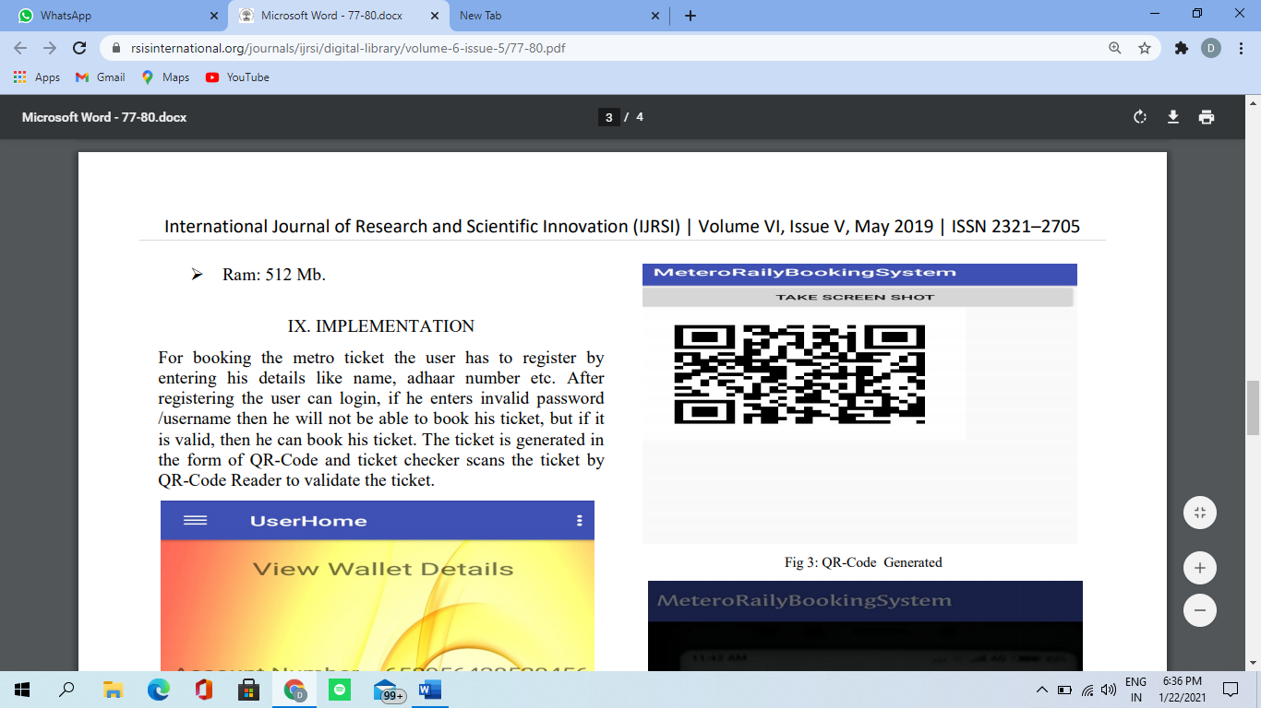
STEP-3
Generating Quick Response Code: When the user books the ticket then the information is sent to firebase and the QR-Code is generated on the server side and sent back to the application.
The QR-Code contains the ticket number, username, source and destination stations.
QR code generation

Slide 8

STEP-4
Ticket Validation: It contains details like when the user buys ticket, source geo points, destination geo points, number of tickets, date, expiry time everything will be stored in firebase. The service checks the user location with destination geo points. When the ticket is rescanned then the ticket will get expired and ticket will be valid only for one day within the metro timings.
Ticket Validation

Slide 9
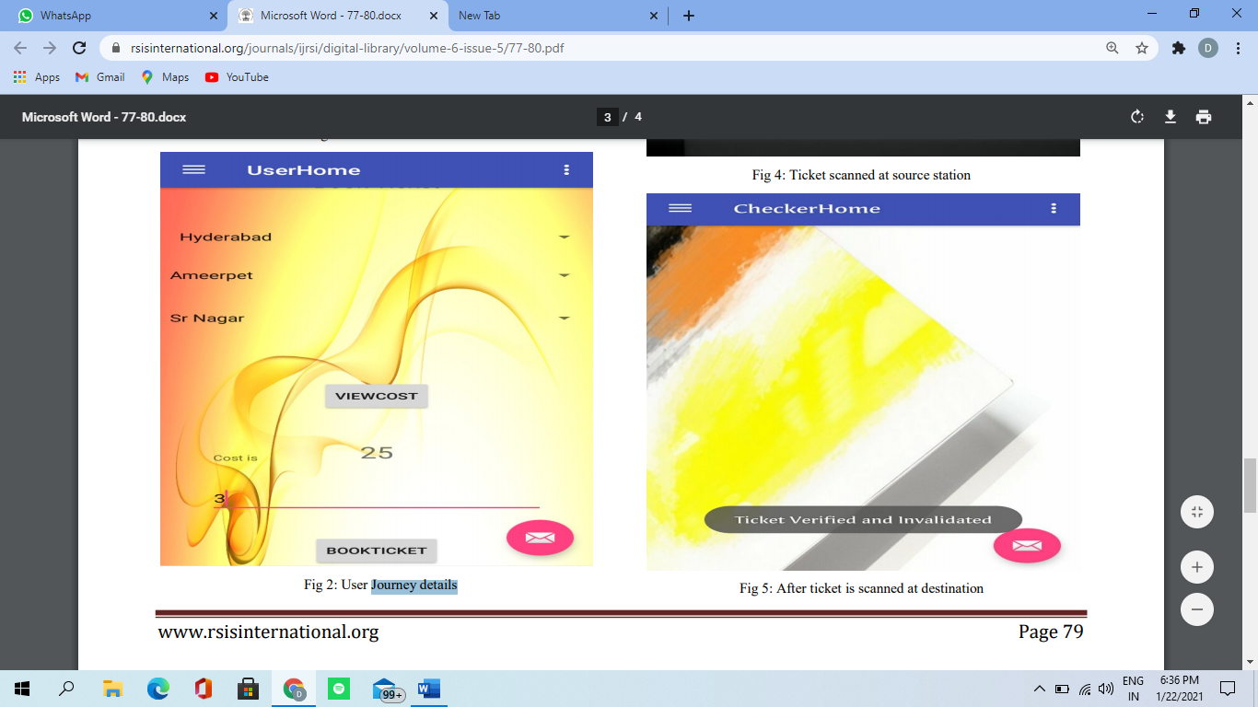
STEP-5
Checking QR-Code with QR-Reader: In this module, the checker will be having the QR-Code Reader and scans the QR-Code in the application in order to validate the ticket. If the user has exceeded the destination station then amount will be deducted from his wallet. Otherwise, if user has dropped in between station then amount will be refunded back to his account.
Ticket Verification

Slide 10
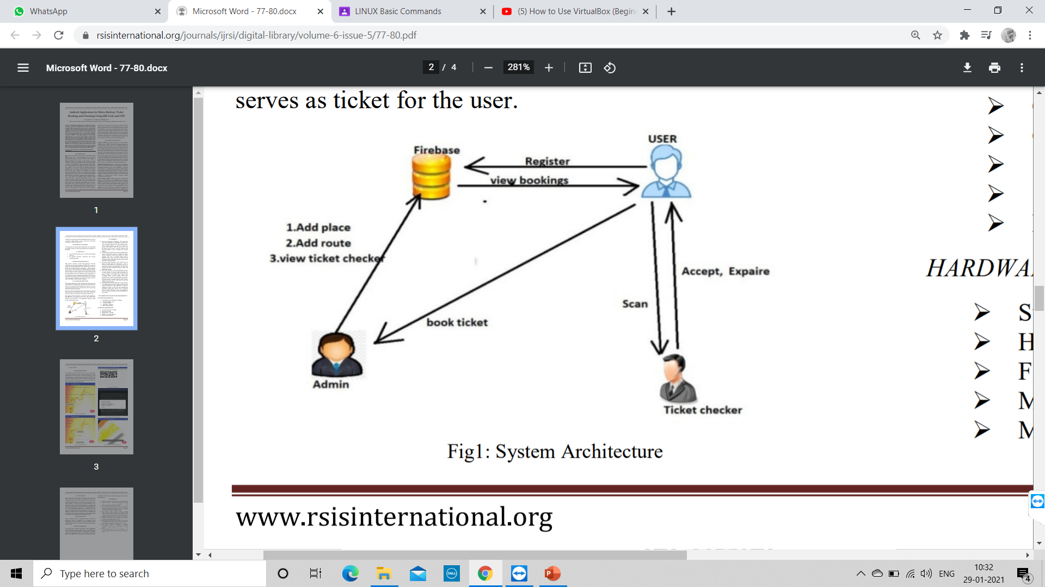

Slide 11
ADVANTAGES:-
Easy for booking and cancelling.
Very simple to find the location of the trains.
Time saving process.
Can schedule the journey into calendar.
Reducing cost from offline booking.

Slide 12
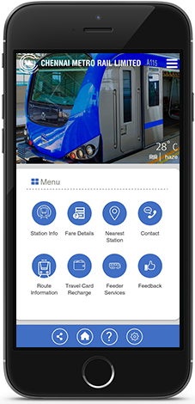
FUTURE SCOPE :-
There is always scope for innovation when it comes for technology. Even our project is no exception. Some improvements has to be made in the future. And making use of GPS to track down the location of the passenger and the nearest station.
In case of any emergency you have the chance
to cancel the ticket and get your money back.
We can get call center support at any time u
need the help.

Slide 13
ROLES AND RESPONSIBILITIES
Project manager
Business analyst
Consultant
UI/UX Designer
Developer
Tester
Deployment team

Slide 14
STRATEGIC BUSINESS CONTEXT:
Business needs:
In this ongoing busy world, everyone will be thinking of going in a smart way of travelling. Booking of tickets in a online mode will be of a great use of travelling in metro.
Business outcomes:
The outcome was expected to be high and good. Most of the problems of booking tickets will be solved and it is simple to use.

Slide 15
DETAILED BUSINESS PROBLEM:
Problem statement:
To design and develop an application for maintaining the details of the user, QR-Code generation and validation of the ticket for getting reservation.
Requirements:
Though the requirements are simple but definitely user needs a printer , desktop, sufficient storage and security.

Slide 16
Assumptions:
Since application is internet based , the user need a basic knowledge of choosing correct destination and should have the knowledge of making payment.
Updating of data may take some time.
Recovery of previous data depends on the user knowledge

Slide 17
Constraints:
Budget --- Additional resources
Changes in deadline --- Risk and decrease in quality
Risks:
Careful while doing payment
Selecting of correct destination

Slide 18

The steps to overcome the risks are:
We have to be careful while doing payment
Selecting of correct source and destination
Keeping the ticket safely until u reach the destination.
There are other members to help in the project budget ,even though the budget is more
Prior analysis is there in every task.

Slide 19
Project team structure and Roles and Responsibilities:
Project steering committee :-
Understanding whole project and analysing
Project sponsor:-
Evaluating the project actuals progress and managing the sponsorship
Project manager:-
Planning, organizing and directing the completion of specific projects. Organizing and tracking the work

Slide 20
Technical lead
Overseas the complete company’s technical team and all risks of the project. Leading developer and tester to build the application
Business analyst
Creating a detailed business analysis, outlining problems Understands the needs and problems of clients
Developer
Writing and implementing efficient code.
Developing the application
Tester
Executes all levels of testing.
Creating test plan and develop test cases

Slide 21

In Scope and Out scope of the project:-
2
+
Assisting the staff in capturing the effort spent on their respective working areas.
Utilizing resources in an efficient manner by increasing their productivity through automation.
Satisfying the user requirement
Easy to understand by the user and operator
Easy to operate
Good user interface
Expandable

Slide 22

Use Case Diagram:-
A use case diagram is a dynamic or behavior diagram in UML. Use case diagrams model the functionality of a system using actors and use cases. Use cases are a set of actions, services, and functions that the system needs to perform. The "actors" are people or entities operating under defined roles within the system.

Slide 23

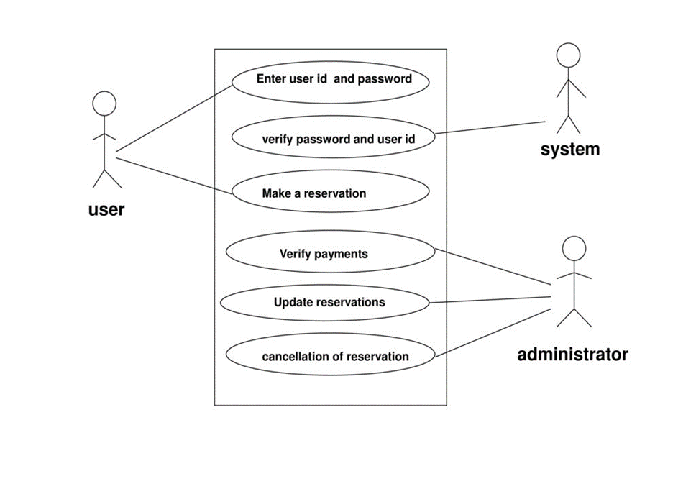
Use Case Diagram

Slide 24

ER Diagram:-
An entity relationship diagram (ERD) is a representation of data within a domain. It consists of entities as well as relationships between entities. Every entity must have at least one attribute that can be used to uniquely identify the entity, which is known as the entity's primary key.

Slide 25
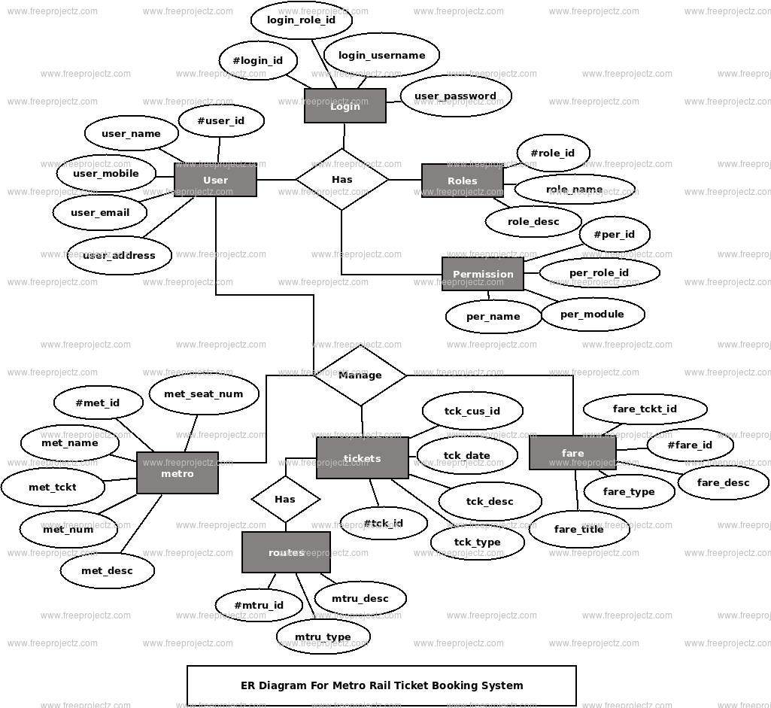
ER Diagram

Slide 26

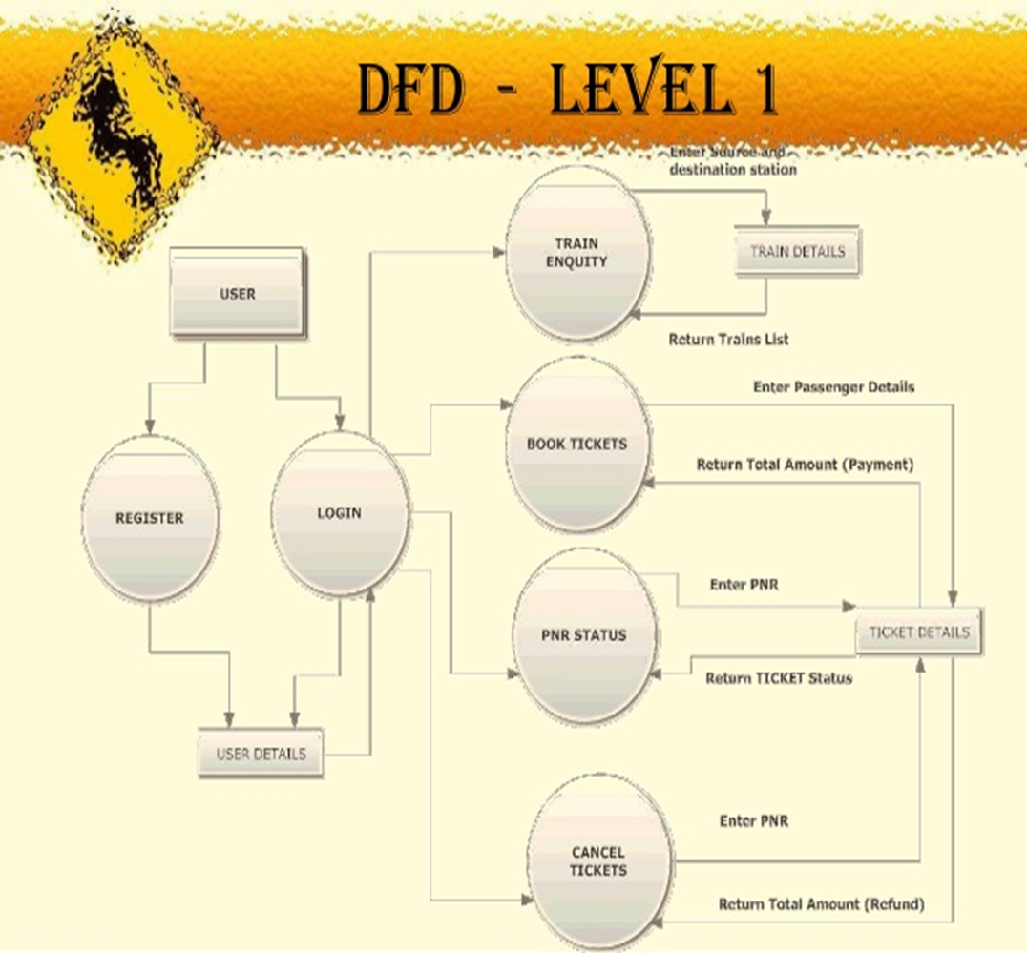
DFD Diagram:-
A data-flow diagram is a way of representing a flow of data through a process or a system (usually an information system). The DFD also provides information about the outputs and inputs of each entity and the process itself. When using UML, the activity diagram typically takes over the role of the data-flow diagram.

Slide 27
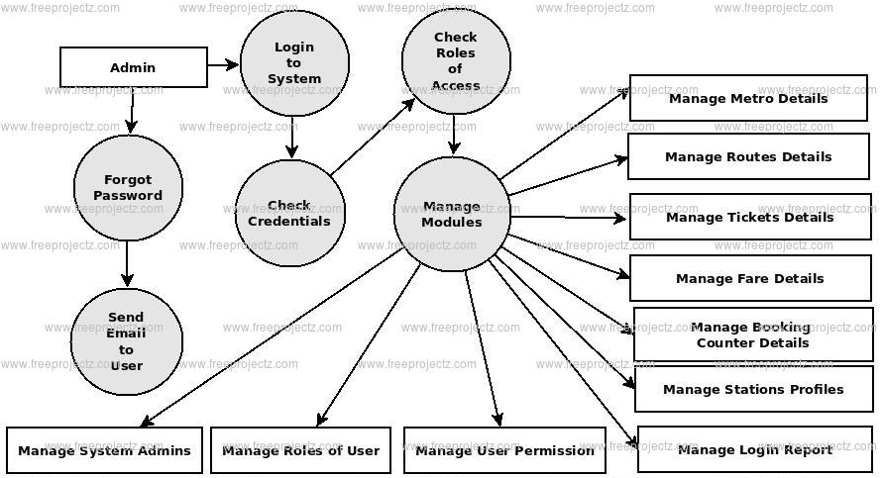

DFD Diagram-2

Slide 28
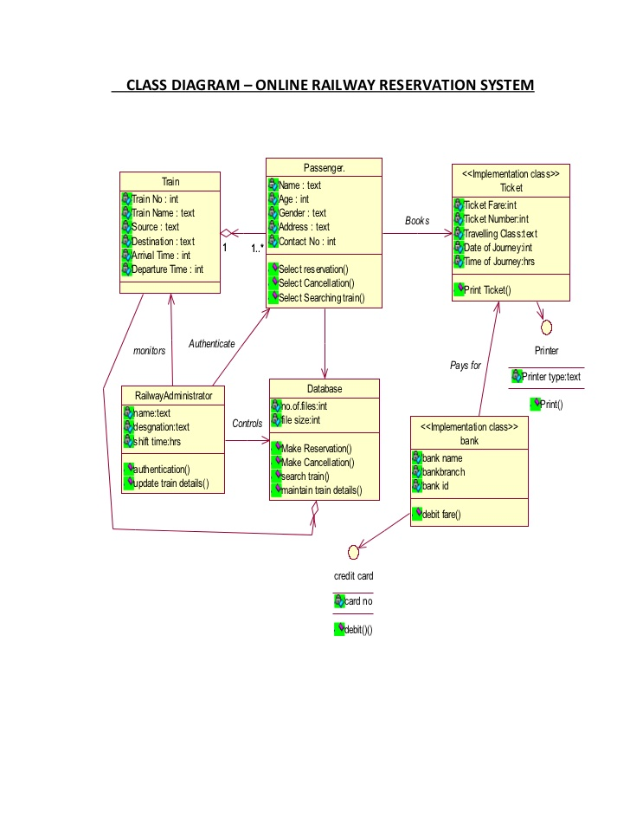
Class Diagram:-
A class diagram in the Unified Modeling Language (UML) is a type of static structure diagram that describes the structure of a system by showing the system's: classes, their attributes, operations (or methods), and the relationships among objects.

Slide 29
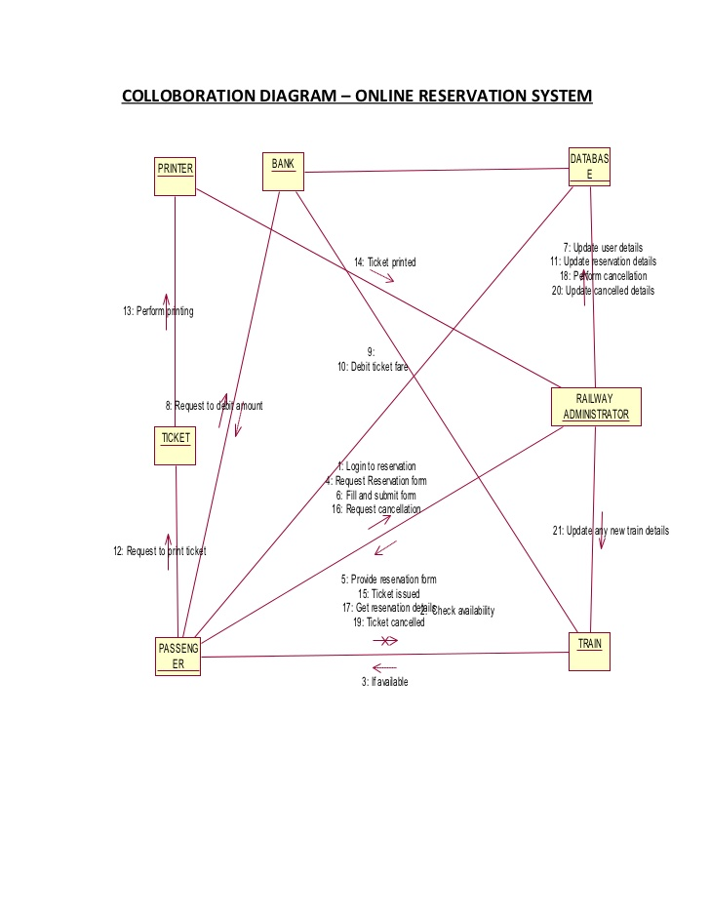
Collaboration Diagram:-
Collaboration diagrams are used to show how objects interact to perform the behavior of a particular use case, or a part of a use case. Along with sequence diagrams, collaboration are used by designers to define and clarify the roles of the objects that perform a particular flow of events of a use case. They are the primary source of information used to determining class responsibilities and interfaces

Slide 30
Architecture Diagram :-
An architectural diagram is a diagram of a system that is used to abstract the overall outline of the software system and the relationships, constraints, and boundaries between components. It is an important tool as it provides an overall view of the physical deployment of the software system and its evolution roadmap.

Slide 31
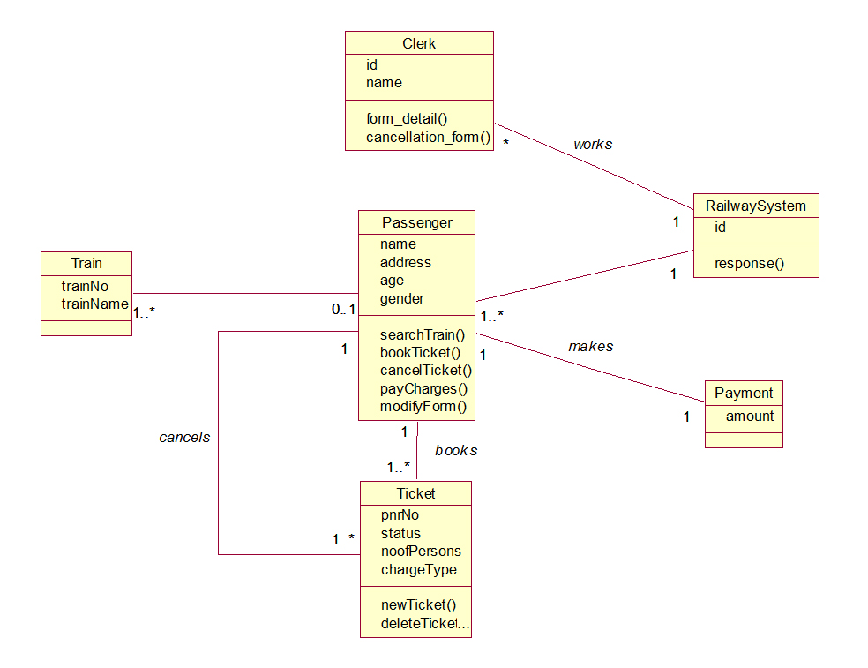

Slide 32
State Diagram:-
A state diagram is a type of diagram used in computer science and related fields to describe the behavior of systems. State diagrams require that the system described is composed of a finite number of states; sometimes, this is indeed the case, while at other times this is a reasonable abstraction. State diagrams are used to give an abstract description of the behavioral of a system.This behavior is analyzed and represented by a series of events that can occur in one or more possible states. Here each diagram usually represents objects of a single class and track the different states of its objects through the system

Slide 33
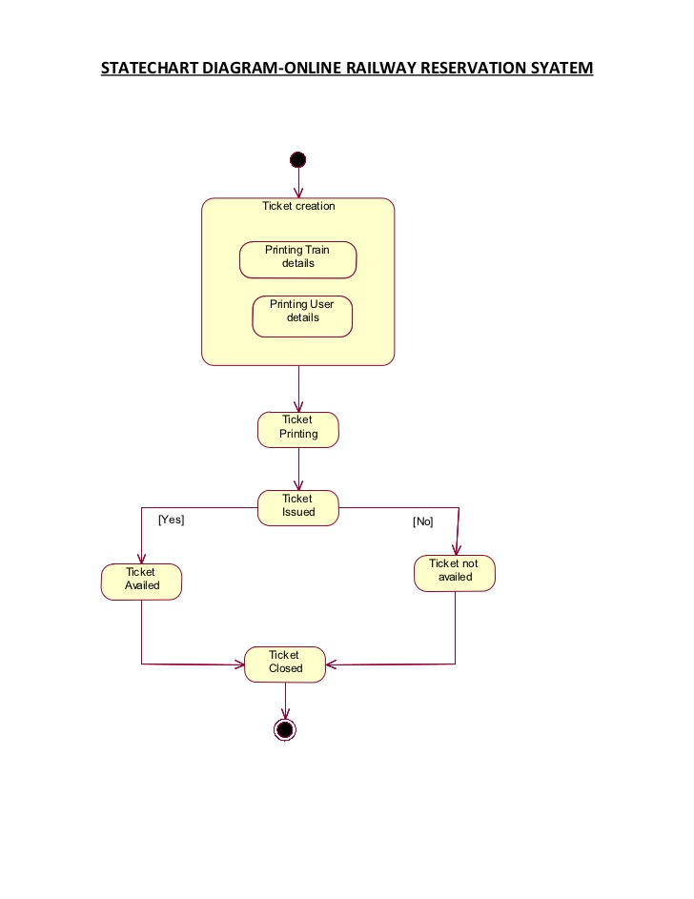

Slide 34
Deployment Diagram:-
UML deployment diagram is a diagram that shows the configuration of run time processing nodes and the components that live on them. Deployment diagrams is a kind of structure diagram used in modeling the physical aspects of an object-oriented system. They capture the hardware that will be used to implement the system and the links between different items of hardware. It is a model of physical hardware elements and the communication paths between them

Slide 35
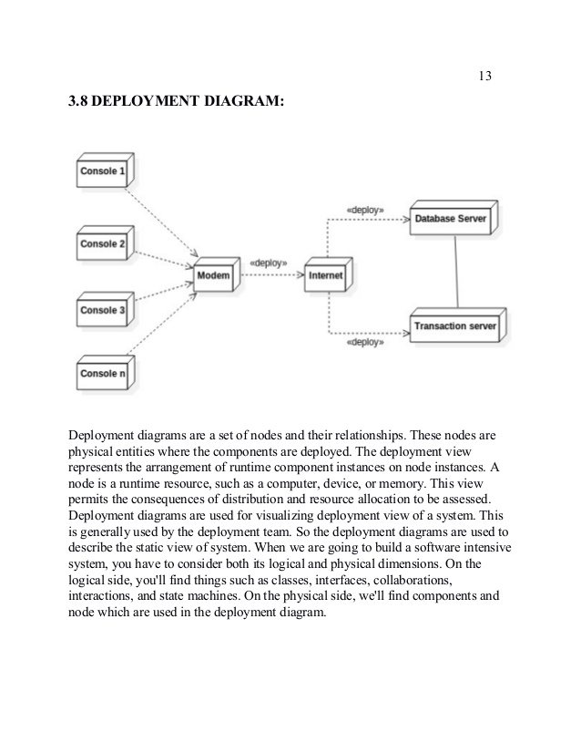

Slide 36



front end design:
Front end development manages everything that users visually see first in their browser or application. Front end developers are responsible for the look and feel of a site. Front end development is mostly focused on what some may coin the "client side" of development.

Slide 37
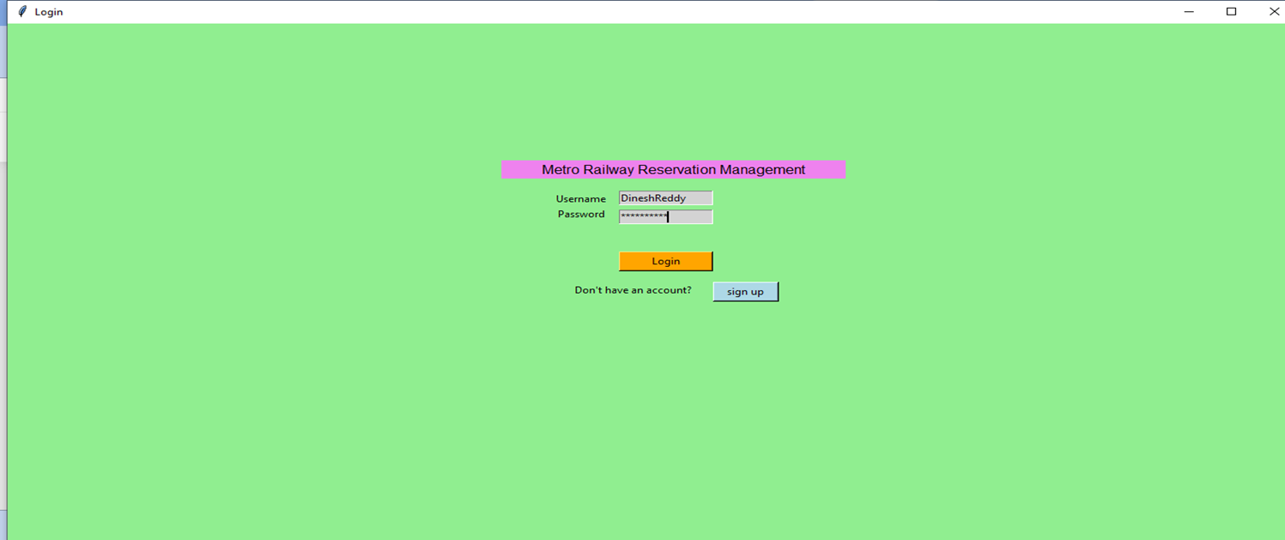
Modules
The frontend of a software program or website is everything with which the user interacts. Websites must work well on multiple devices and screen sizes, which is why modern web development typically involves responsive design.
This is the login page ,where we enter the basic details such as username and password.

Slide 38
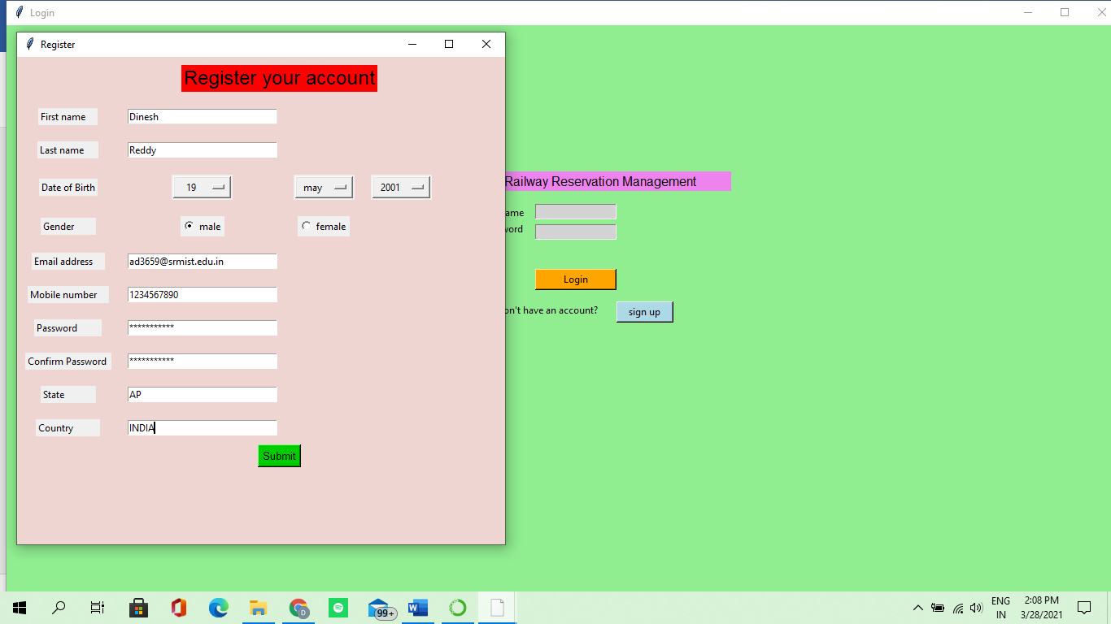

Slide 39
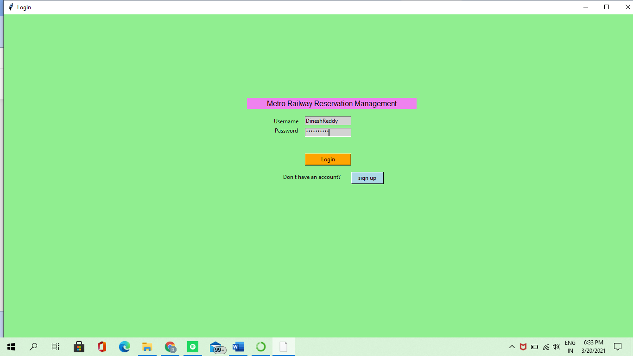
This is the login page ,where we enter the basic details such as the correct username and password.

Slide 40
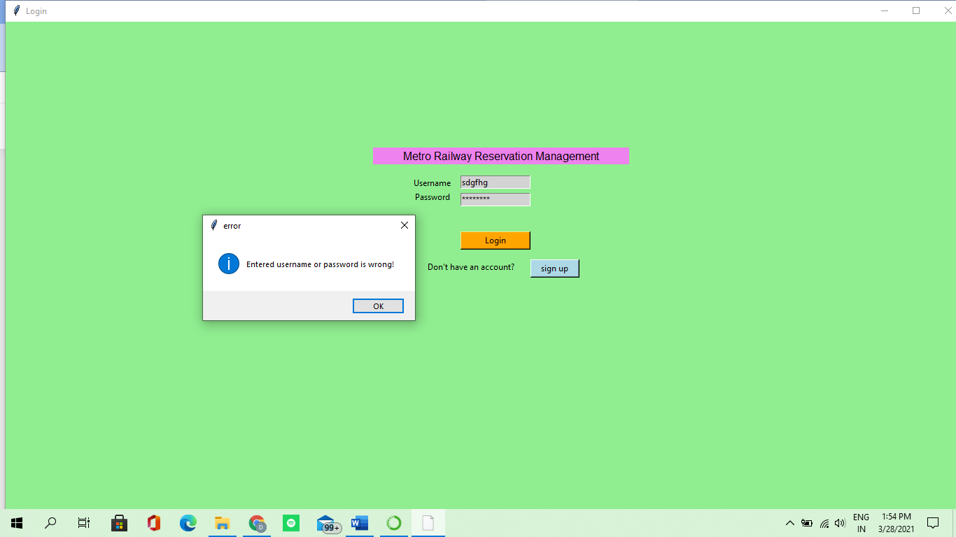
If u enter the wrong username and wrong password, it shows the error that the username and password u have entered is wrong.

Slide 41
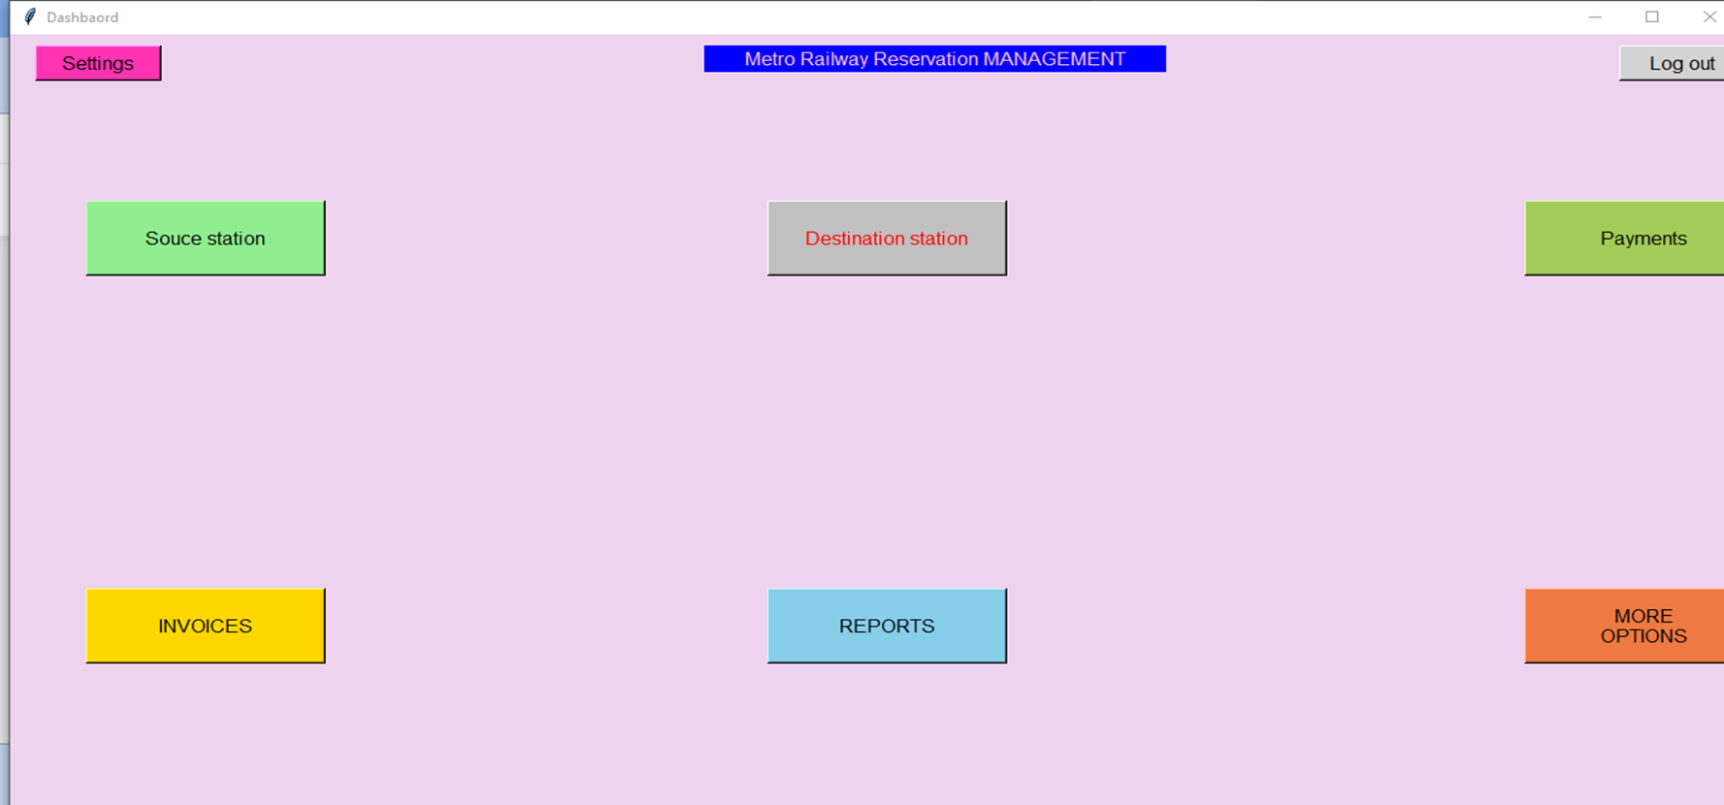
After successfully login, you will enter into one more page where u have to do select the source and destination stations and have to do the payment to get the ticket.

Slide 42
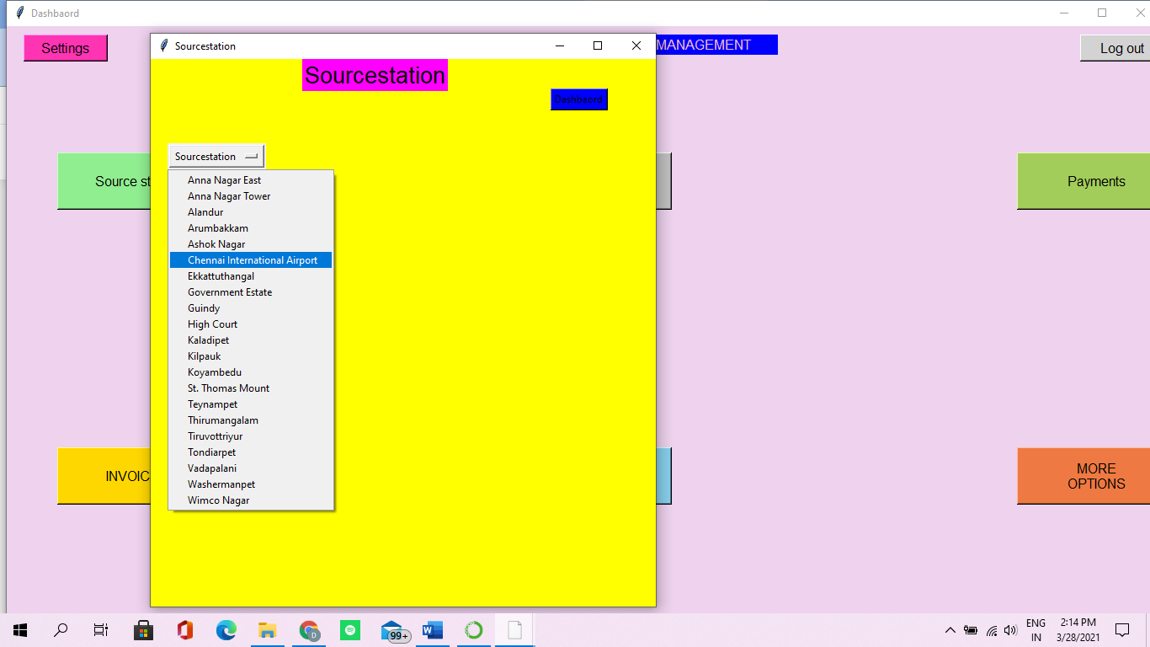
By clicking on the source station, You will be directed to select the starting(source) point of metro station names.

Slide 43
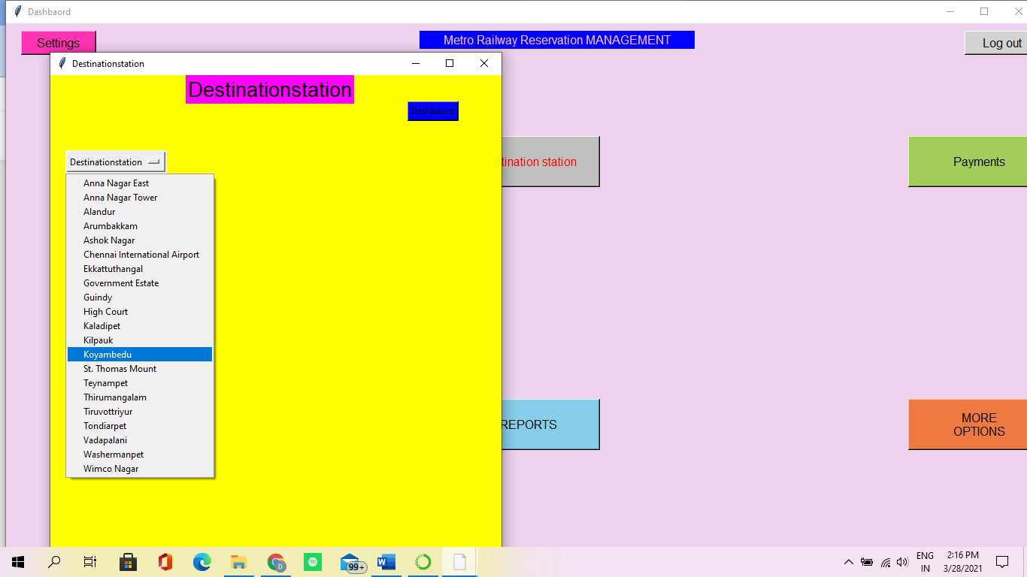
By clicking on the destination station, you will be directed to select the last(destination) point of metro station names.

Slide 44
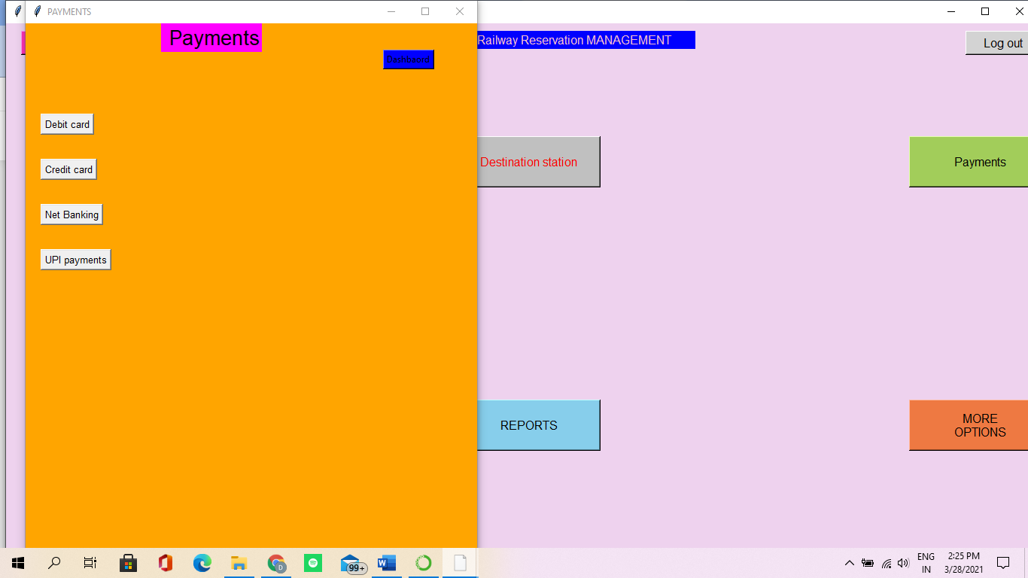
Next ,we have to do the payment by clicking on payment options, it will be directed to different payment methods

Slide 45
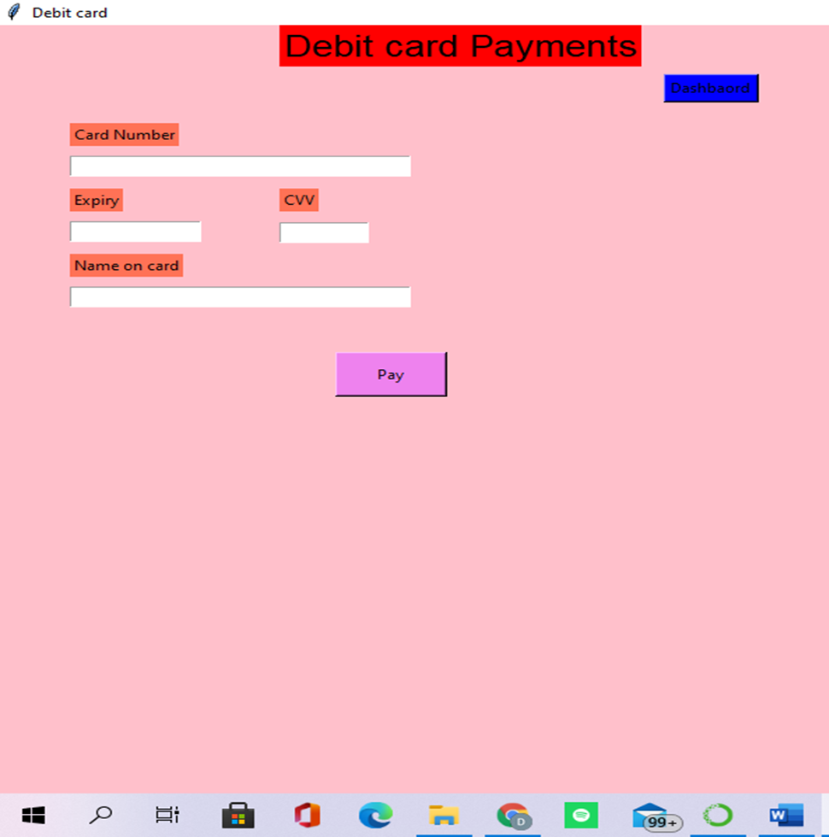
For Debit card payment click debit card and type details related to card, and click on pay button

Slide 46
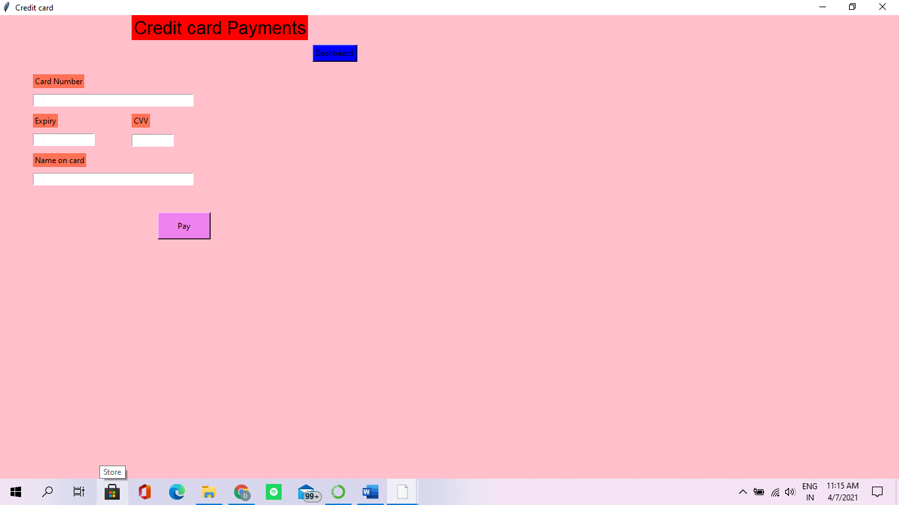
For Credit card payment click credit card and type details related to card, and click on pay button

Slide 47
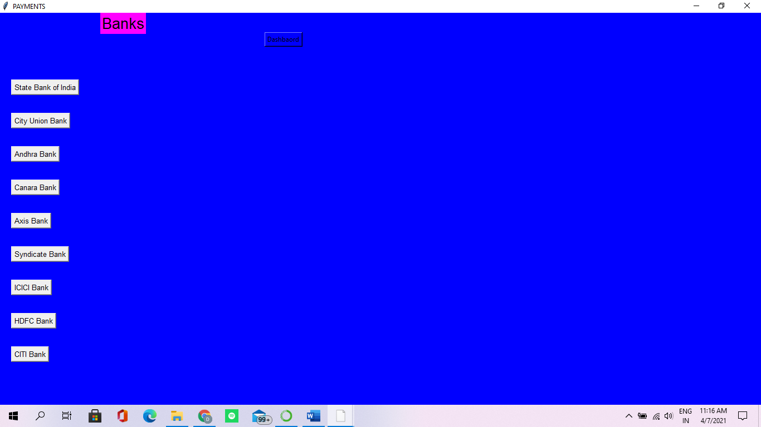
For Net banking payment click net banking and select ur required bank ,it will be redirected to login page of that bank.

Slide 48
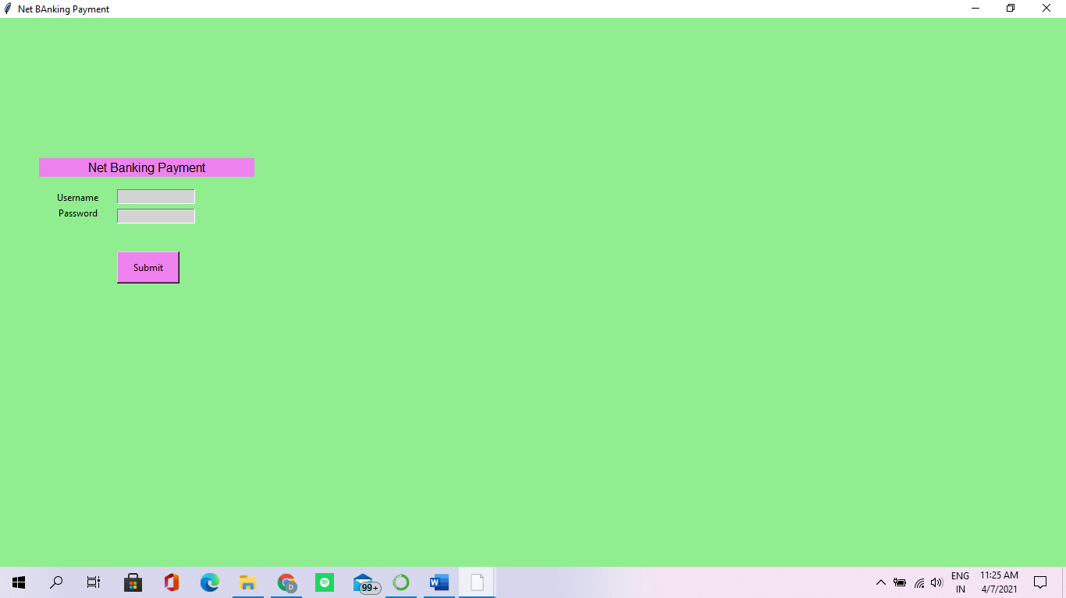
Next, you have to enter the login details of the required bank and click submit button.

Slide 49
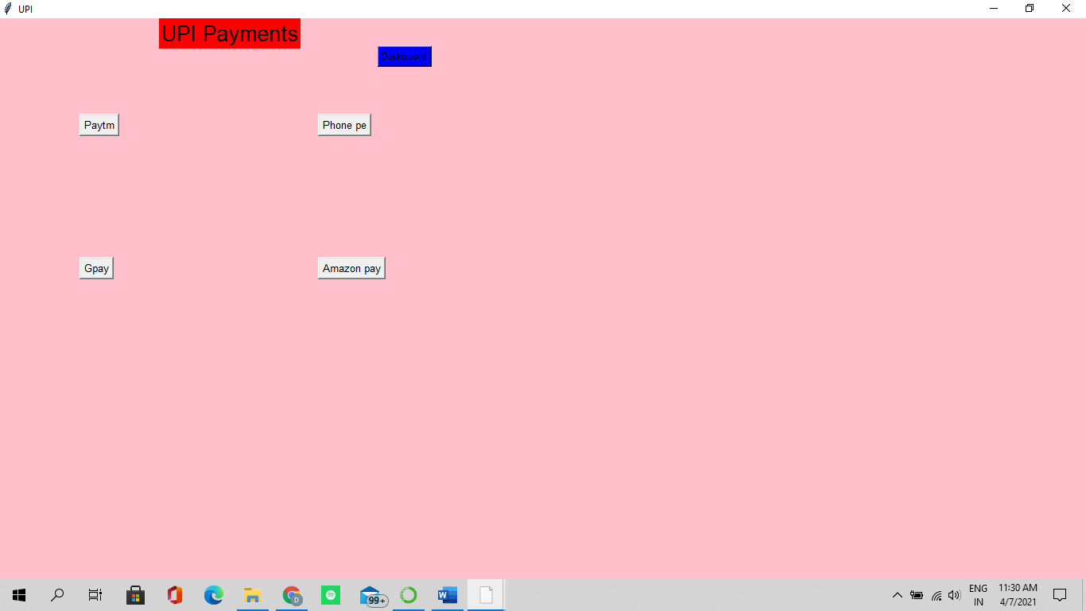
If you want to do UPI payment, click UPI payments and it will be redirected to required UPI payment method.

Slide 50
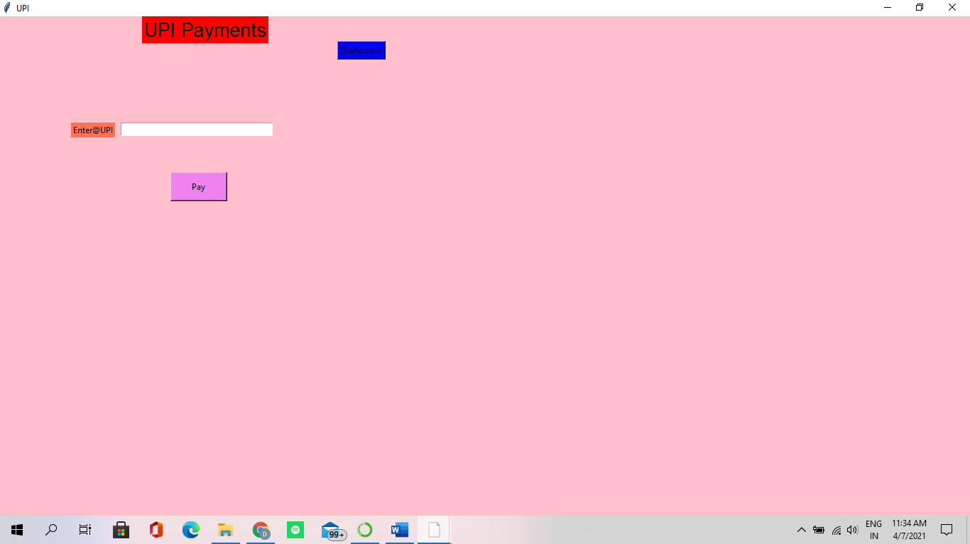
Whatever the UPI payment method u will click, it will ask to enter the upi address and then click pay option for successful payment

Slide 51
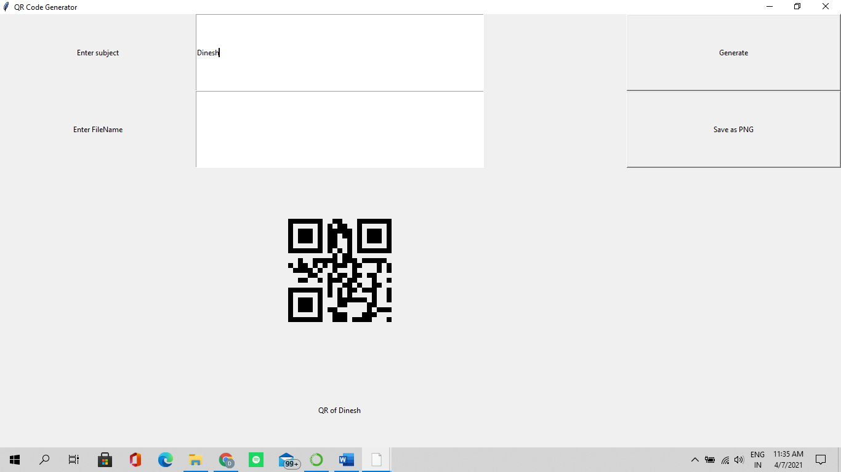
Here we have the QR code which will generates the ticket and also which is inside of Invoices button to be scanned by the ticket collector from every passenger.

Slide 52
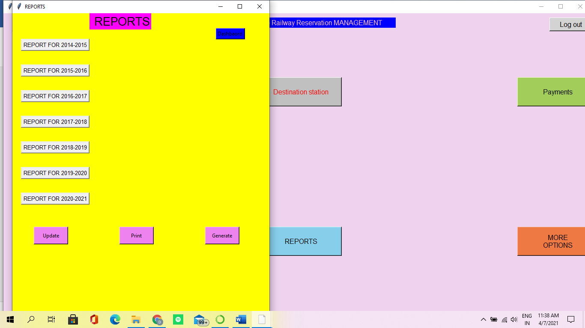
If we want to see the booking history we can click on Reports button ,you will get the previous registered tickets from bookings list for any information you needed.

Slide 53
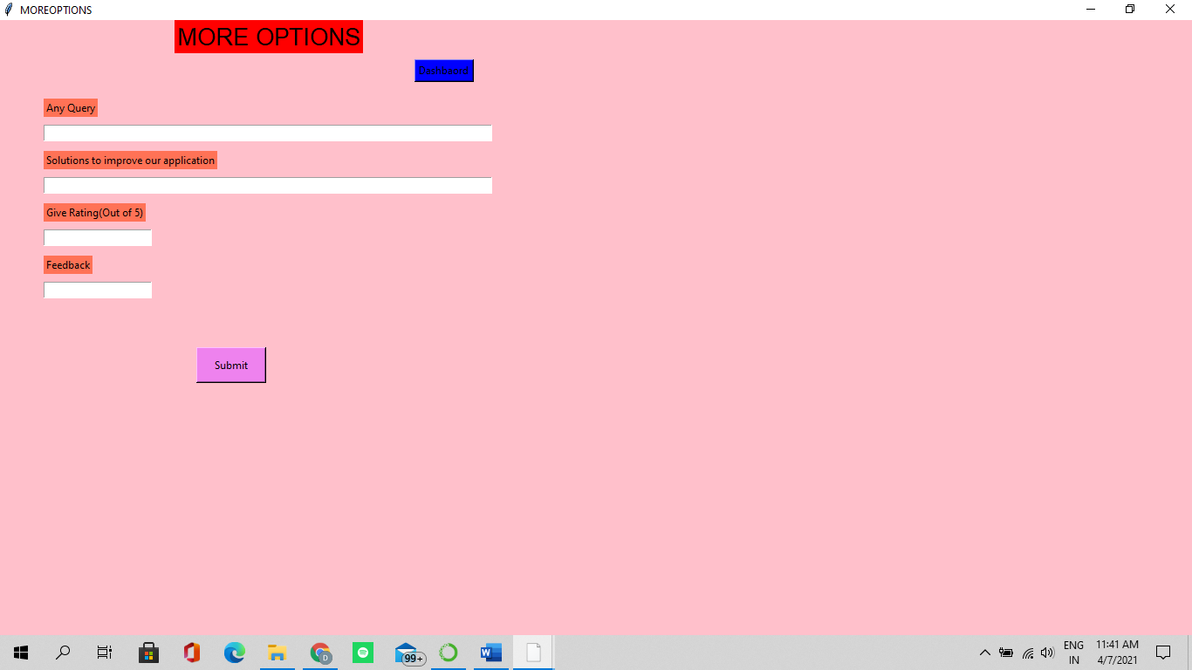
If you have any issue regarding any type of error or any problem and also if you want to give any feedback u can click the More Options button there and fill the form so you can get help from the officers within time.

Slide 54
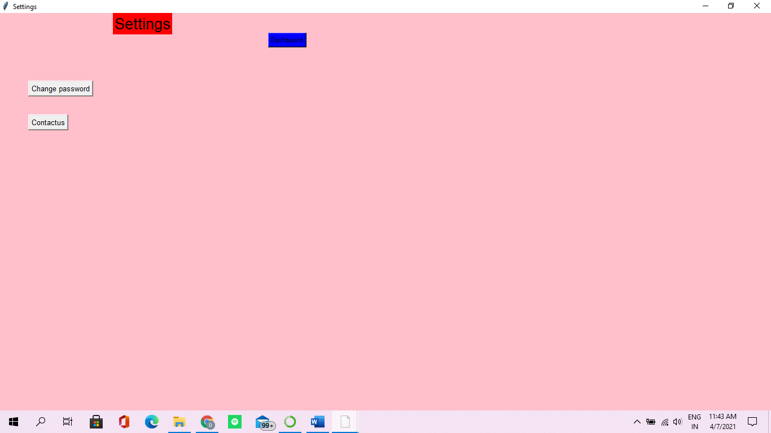
Here If you want to change the password or to contact us ,you can go to settings and click the change password button to change the password

Slide 55
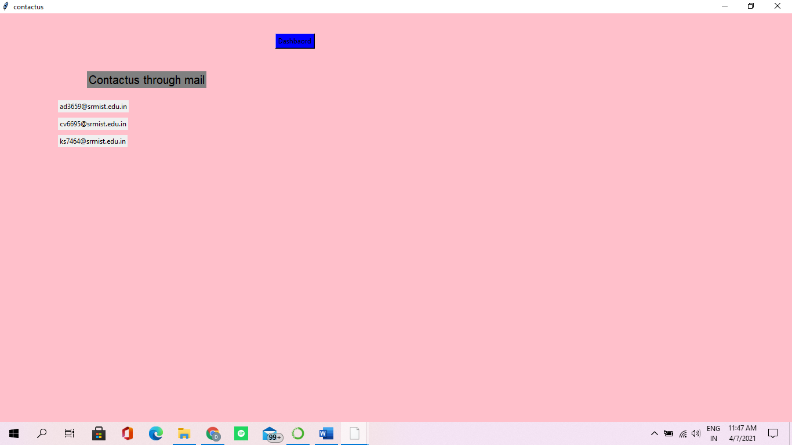
And for any help or If you want to contacts with us for any information needed ,you can contact through our given mail’s

Slide 56
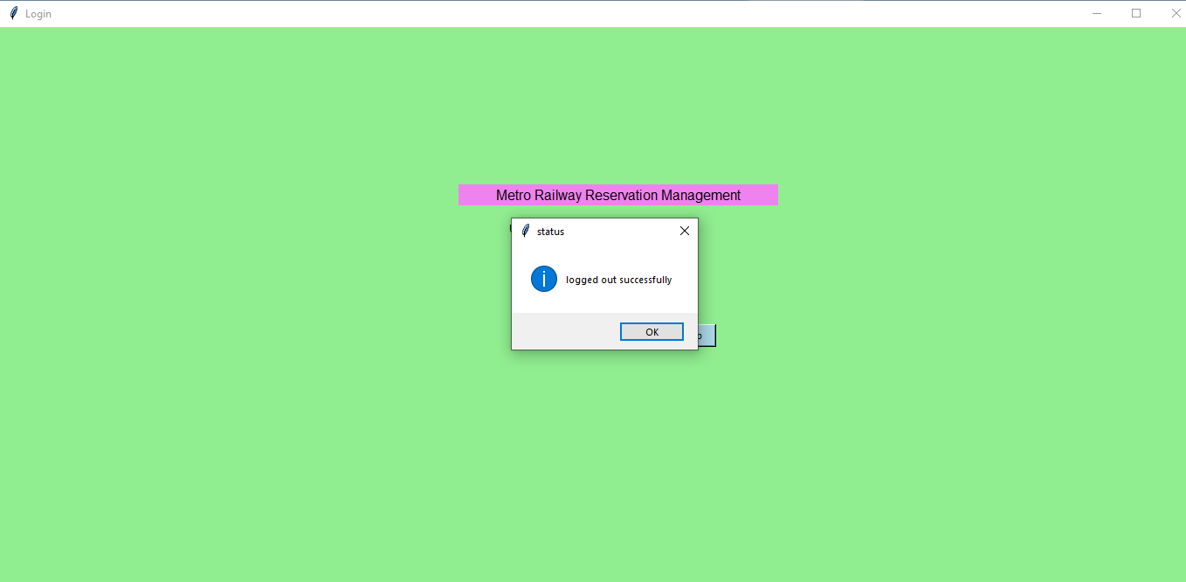
After doing payment, you have to click the logout button, then a message will be displayed as you have logout successfully

Slide 57
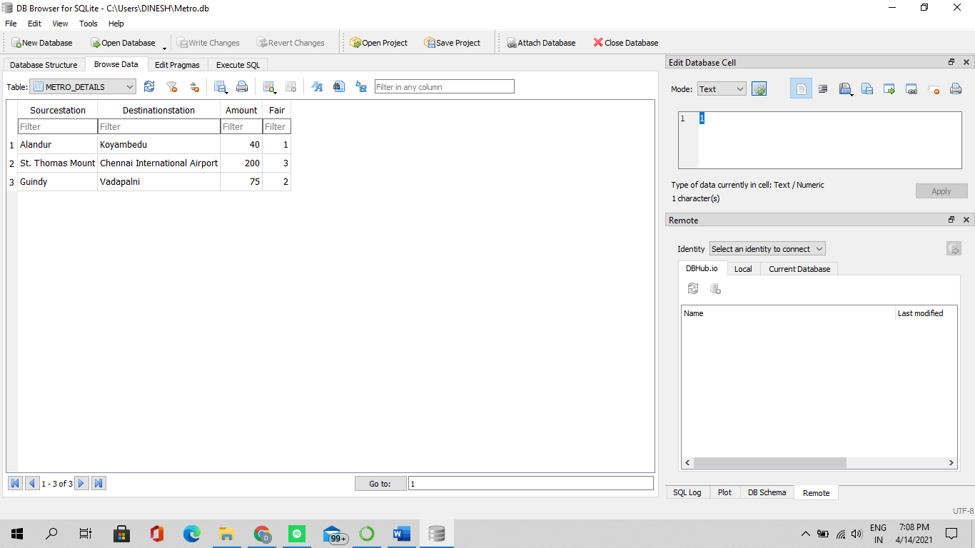
All the data and selected values u give will be stored in database of sqlite in the back end of the project

Slide 58
Types of testing, Methodology, Tools:
Category | Methodology | Tools requirement
Functional requirements | manual | GUI testing, Regression testing, Backend testing
Non-functional requirements | manual | Performance testing

Slide 59

Test deliverables:
Test plan
Test strategy
Bug report
Test execution report
Test summary
User guide
Installation and configuration guide
Release note

Slide 60
TEST CASE: Functional test cases:
Test ID | Test scenario | Test case | Execution steps | Expected outcome | Actual outcome | status | remarks
#FT1 | Verifying data | Accept valid names and numbers | User needs to enter the data in each module | matched | matched | Pass | success
#FT2 | Data stored in sqlite | Verification of stations | Need to save the correct station names by default type | matched | matched | Pass | success

Slide 61
Test ID | Test scenario | Test case | Execution steps | Expected outcome | Actual outcome | status | remarks
#FT3 | Login credentials | Accept username and password | User needs to enter the data in given entries | Logged in and dashboard will appear | Logged in and dashboard will appear | Pass | success
#FT4 | Netbanking payment | Acceping username and password | User needs to enter the data in given entries | Logged in to the bank server | Logged in to the bank server | Pass | success

Slide 62
Non functional test case:
Test ID | Test scenario | Test case | Execution steps | Expected outcome | Actual outcome | status | remarks
#NFT1 | Performance testing | Time limit required | The time required to enter correct password is limit based | Logged in and dashboard will appear | Logged in and dashboard will appear | Pass | success

Slide 63
Test Report:-
Category | Progress | Status
Functional Testing | Completed | Successful
Non Functional Testing | Completed | Successful
Functional | Test case Coverage | Status
Verifying data | 100% | Completed
Verifying booked stations | 80% | In Progress

Slide 64


